Slide 1
Usage guide for ctags

Slide 2
What is ctags?
Unix command that makes database of programming sources’s
tag (ex. Global variable, function definition, macro declaration)
We can recognize where function and variable are using tags file.

Slide 3
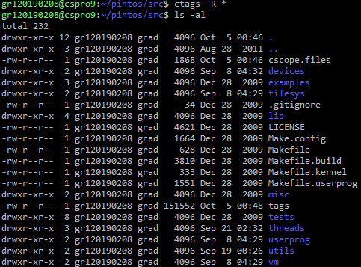
Generate tags file
Command ctags –R * on pintos/src directory.
Then ctags create tags file.

Slide 4

Register tags file at .vimrc
Add line at .vimrc file
Then when launch vim, it finds tags file.

Slide 5
Shortcuts when using ctags on vim
Ctrl + ]
Go to declaration point of function or variable.
Ctrl + t
Go back previous tags or code.
Google it to see more commands or shortcuts.

Slide 6
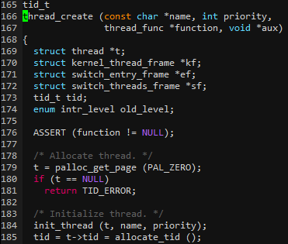
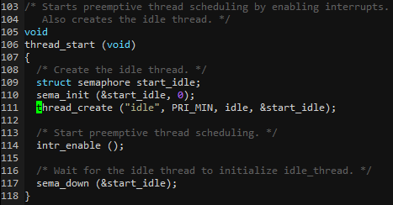
Example
Ctrl + ]

Slide 7
Example
Ctrl + t

